Slide 1
ANOMALY DETECTION IN HUMAN EMOTIONAL ANALYSIS
PRESENTED BY
Bandi Shivani
Padala Soumya

Slide 2
ABSTRACT
Anomaly detection in human emotion analysis involves identifying unusual patterns in emotional data. This approach aims to detect outliers or anomalies that significantly deviate from typical emotional expressions. Utilizing statistical techniques, deep learning algorithms such as the Inception-V3 model, and machine learning algorithms like SVM, anomalies in human emotion data can be flagged for further investigation. This method can help understand rare emotional states, detect fraudulent behavior, or uncover hidden patterns in emotional responses.
Human emotion detection refers to recognizing and analyzing human emotions through various methods, including facial expressions, voice tone, physiological signals, and text analysis. By using frequency and amplitude characteristics for physiological signals, such as heart rate and skin condition, we aim to accurately interpret human emotions. The goal is to discern and interpret emotional states, including happiness, sadness, anger, neutrality, fear, and more. The datasets used in this project are CK+ and FER2013.

Slide 3
REQUIREMENTS
SOFTWARE REQUIREMENTS
Operating System : Windows 10 or above
Coding Language : Python3.7
Python libraries : OpenCV, TensorFlow
HARDWARE REQUIREMENTS
System : intel i5 or above processor and device should contain a webcam
Storage : Sufficient storage

Slide 4
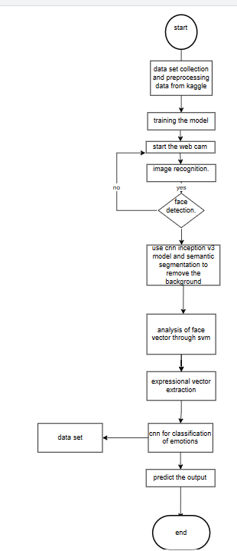
PROPOSED METHODOLOGY

Slide 5
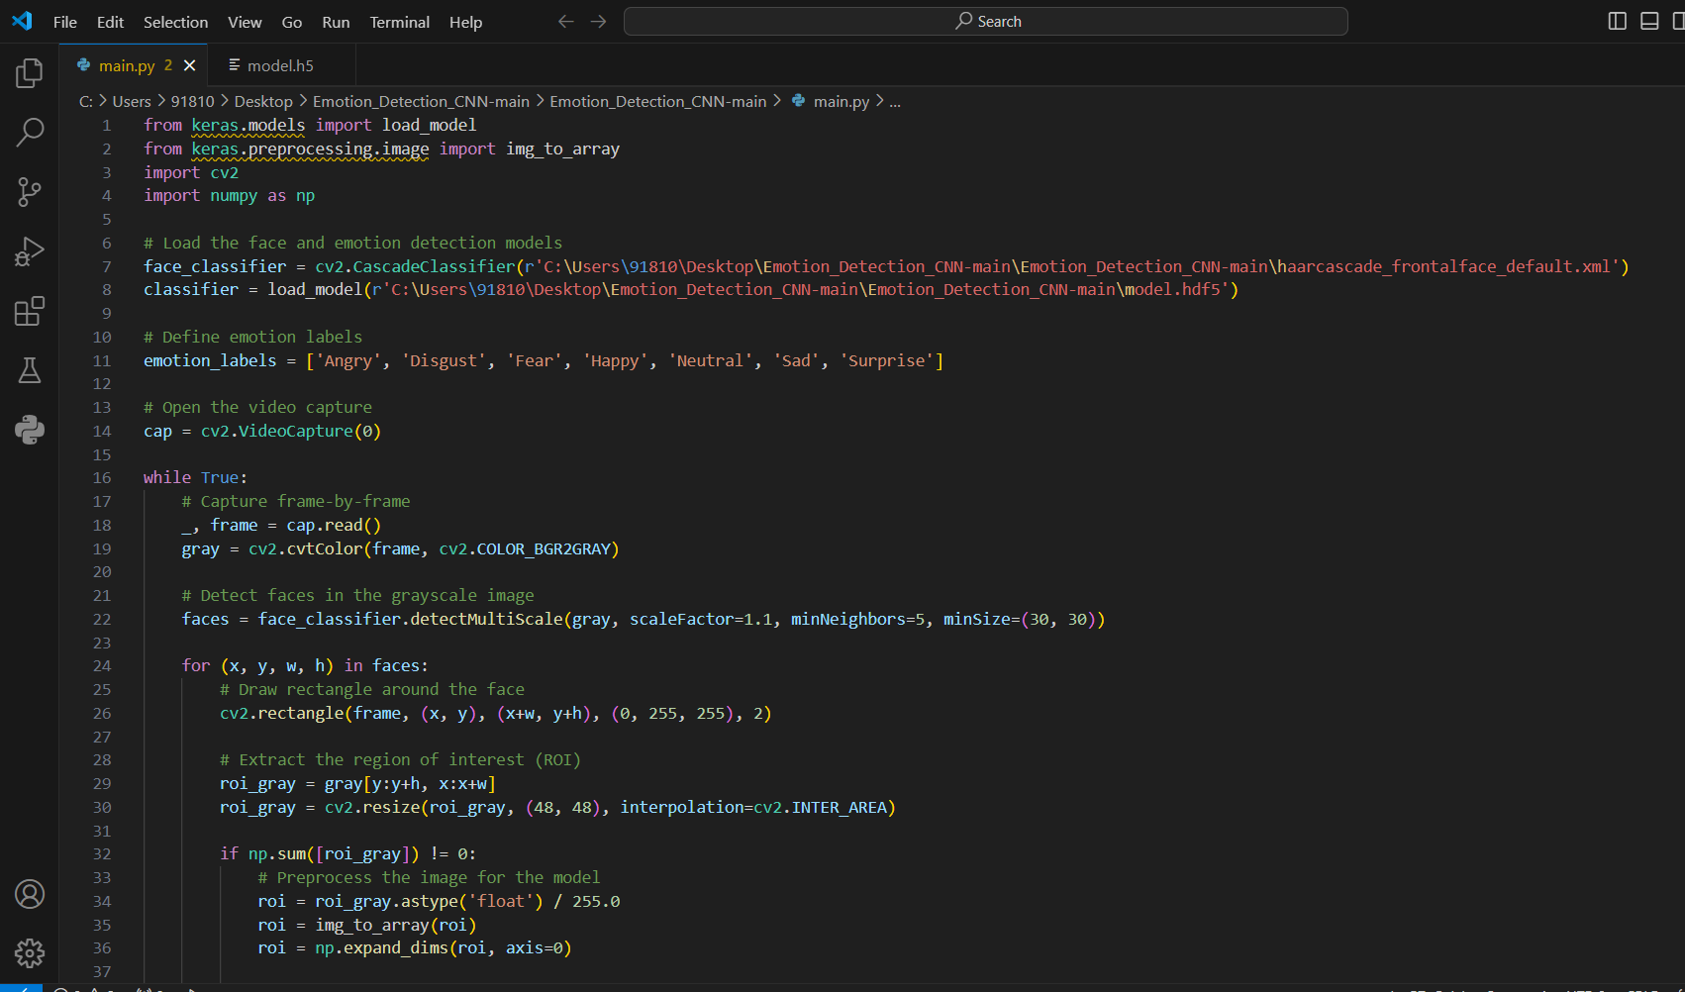

Slide 6
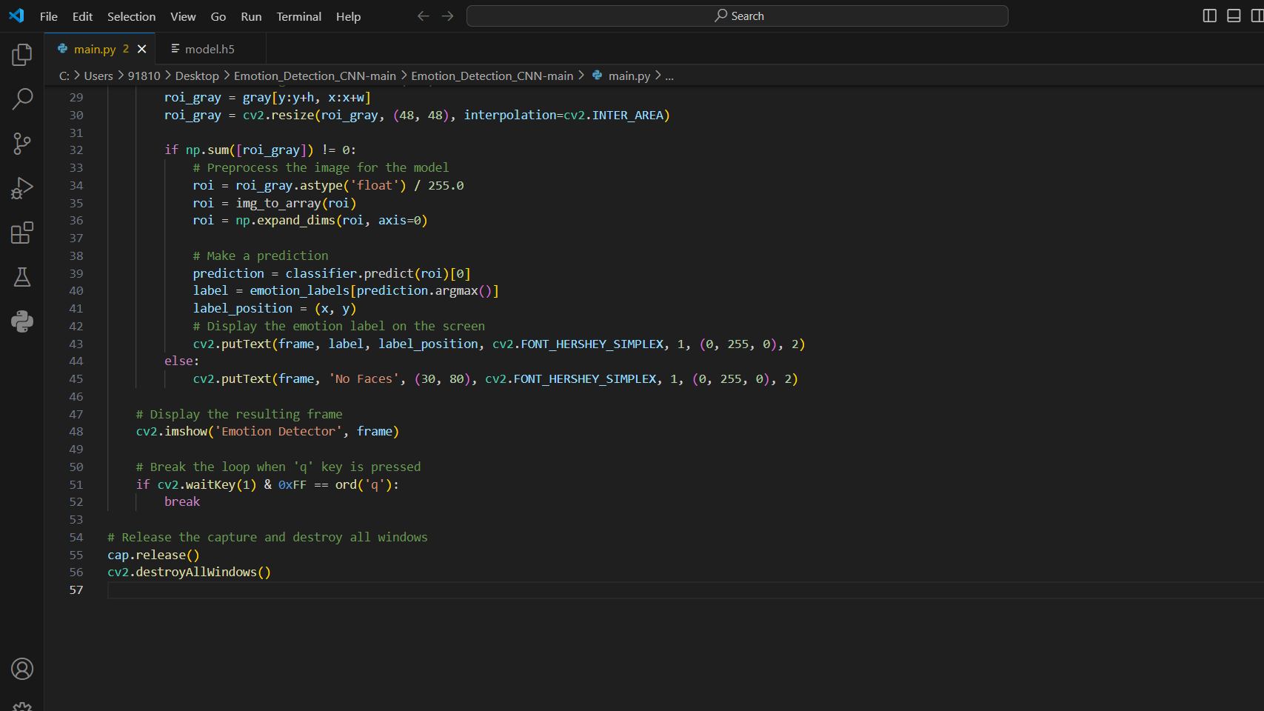

Slide 7
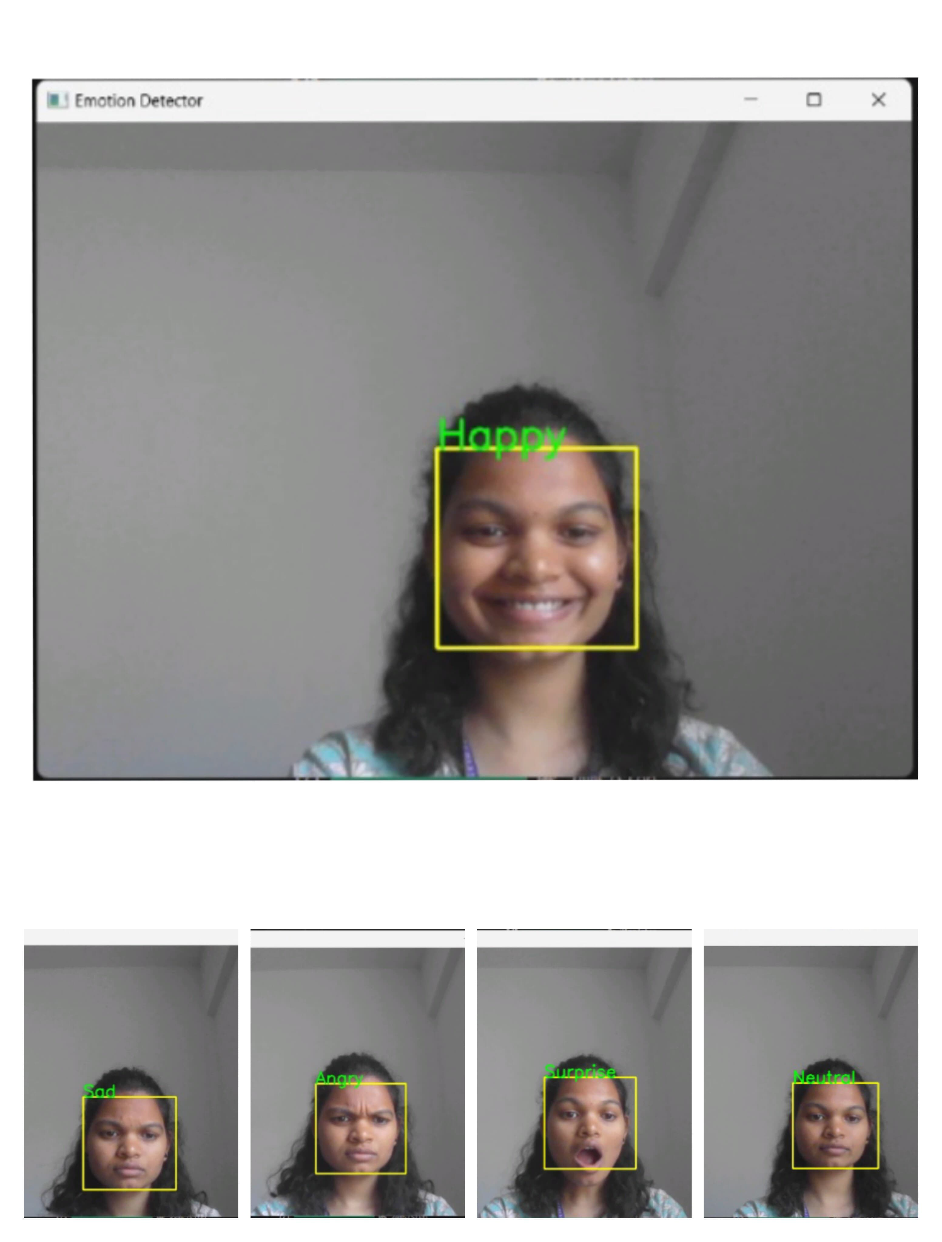

Slide 8
CONCLUSION
This implementation successfully integrates face detection and emotion classification in a real-time application. It demonstrates the practical application of computer vision techniques using OpenCV and deep learning models with Keras. The project showcases a pipeline for capturing video, detecting faces, preprocessing input data, and classifying emotions, all in real time.

Slide 9
FUTURE SCOPE
Enhance accuracy
Integrated with AI and robotics
Add more Emotion Label
Advance human Emotions Integration

Slide 10
REFERENCES
Amit Pandey “ International Journal of Engineering Applied Sciences and Technology Facial Emotion Detection And Recognition ” Vol 7, Issue 1, ISSN No 2455-2143,2022, Pages 176-179.
Haji Binali , Chen Wu, Vidyasagar Potdar “Computational Approaches for Emotion Detection”6t^{h} IEEE International Conference on Digital Ecosystem and Technology 2023 in Text Page 172-176
E . Afful - Dadzie , M.A.H Akhand “ Sentiment Analysis on Images using CNN based on V3 transfer Learning approach ”volume 3,April 2023 ,Page 302-310.

